Slide 1


NANOSTRUCTURED SOLAR CELL

Slide 2
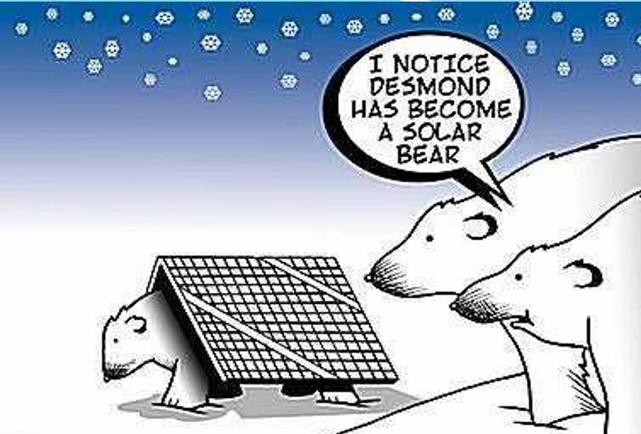

Slide 3
Light on our attempts to
tap solar energy
even at night times when
the sun is not visible.
Future
Enhancements of Solar cell also at night time
We can also even use
at night time
Our innovative idea
frames
a conceptual approach
in combination
with the
nano technology .

Slide 4
CONTENT
1
SOLAR CELL
SOLAR POWER
2
3
INFRARED POWER
PLASTIC SOLAR CELL
4
5
PHOTOVOLTAIC CELL
NANOCRYTALS
6
INTERNAL DESIGN OF NANOSTRUCTURED CELL
7

Slide 5
SOLAR CELL
The most common type of solar cells are Photovoltaic Cells (PV cells)
Converts sunlight directly into electricity
Cells are made up of a semiconductor material (example :silicon)
Light strikes the PV cell, and a certain portion is absorbed
The light energy (in the form of photons) knocks electrons loose, allowing them to flow freely, forming a current
Metal contacts on the top and bottom of PV cell draws off the current to use externally as power

Slide 6
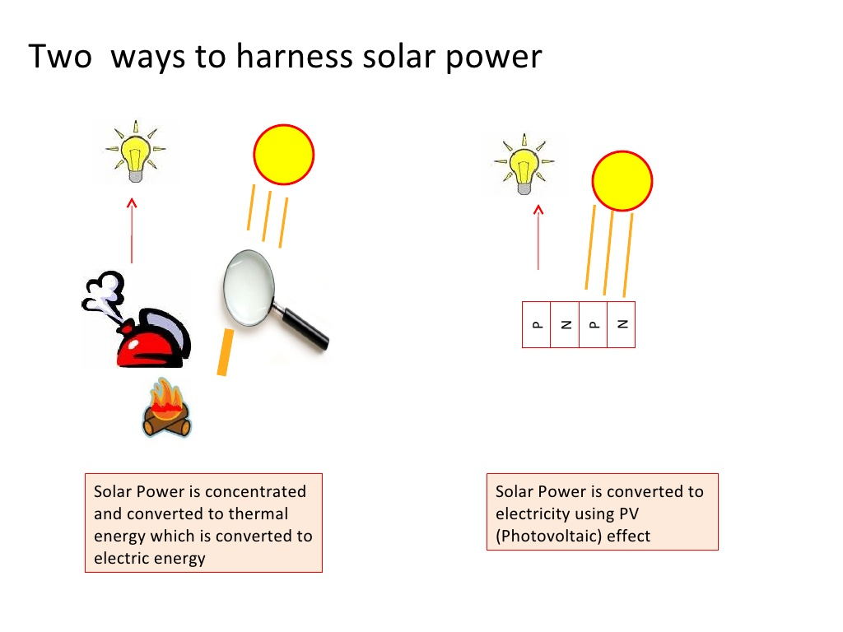
SOLAR POWER

Slide 7


INFRARED POWER
While half of the sun's power lies in the visible spectrum, the other half lies in the infrared spectrum.
The new material is the first plastic composite that is able to harness the infrared portion.
Conventional semiconductor solar cells are made of polycrystalline silicon or, in the case of the highest efficiency ones, crystalline gallium arsenide.

Slide 8
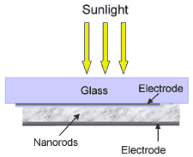
PLASTIC SOLAR CELL AND ITS DESIGN

Slide 9

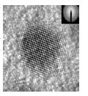
STRUCTURE OF PLASTIC POLAR CELL

Slide 10

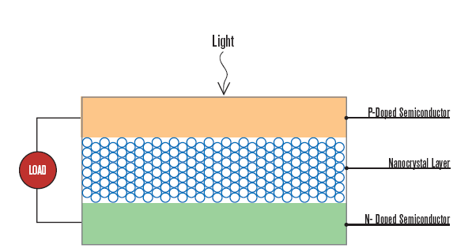
PHOTOVOLTAIC CELL AND NANOCRYSTALS
The nanocrystals are formed onto an ordered 3-D
`array with inter-nanocrystals

Slide 11

OPERATION
Light energy (photons) ionizes the atoms in the silicon and the internal field produced by the junction
separates some of the positive charges (holes)from the negative charges (electrons)
The holes are swept into the p-layer and the electrons are swept into the n-layer
The charges can only recombine by passing through an external circuit outside the material
Power is produced since the free electrons have to pass through the load to recombine with the positive holes

Slide 12
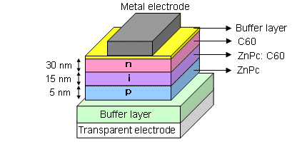
INTERNAL DESIGN OF NANOSTRUCTURED CELL
A p-i-n junction type organic thin-film solar cell is prepared by vacuum deposition process.
Thickness of three layers of organic semiconductor is 5 nm for p-layer,
15 nm for i-layer and 30 nm for
n-layer, totaling 50 nm.

Slide 13

FUTURE ENHANCEMENT

Slide 14

QUERIES
????

Slide 15

DONE BY:
JEGADEESWARI.J.S.
JANANI.S.
SHUBHA NANDHINI.G.
SARAVANA.G.
MADHUSHREE.S.

